Slide 1
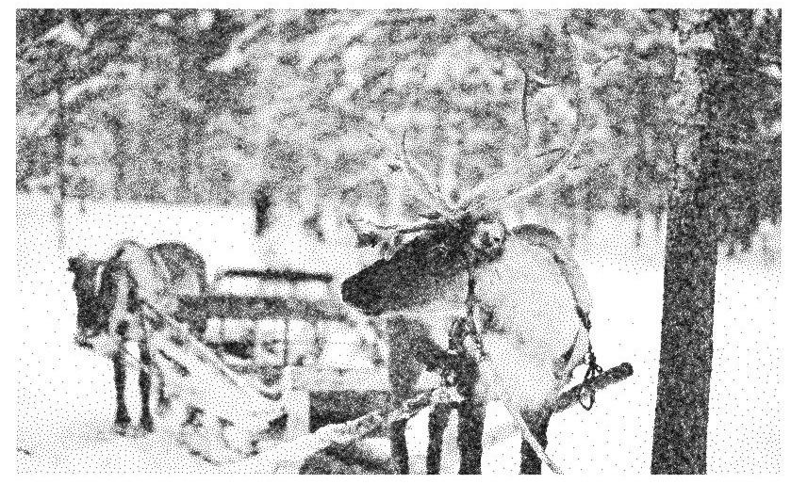
Traveling Santa 2018 – Prime Paths Kaggle Competition
1,874 teams; $25,000 in prizes; ended January 10, 2019
Presented by Stan Kriventsov

Slide 2
Problem Statement
A variation of the Traveling Salesman Problem
197,769 cities with IDs 0, 1, 2, ..., 197768
The goal is to minimize the length (Euclidian distance) of a closed path starting and ending at city 0
The length of every 10th step is increased by 10% if this step does not originate from a city with a prime ID (2, 3, 5, 7, 11, ...)
The cities are taken from pixels in the picture on the previous page

Slide 3
The data (cities.csv)
CityId, X, Y
0, 316.836739061509, 2202.34070733524
1, 4377.40597216624, 336.602082171235
2, 3454.15819771172, 2820.05301124811
3, 4688.09929763477, 2935.89805580997
...
197768, 1354.76477830356, 3218.10062536298
X: (0, 5100), Y: (0, 3400)

Slide 4
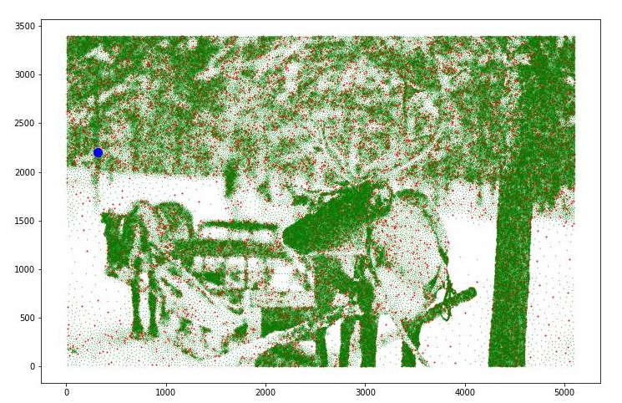
Starting city and prime city locations (green – non-prime, red – prime, blue – city 0)

Slide 5
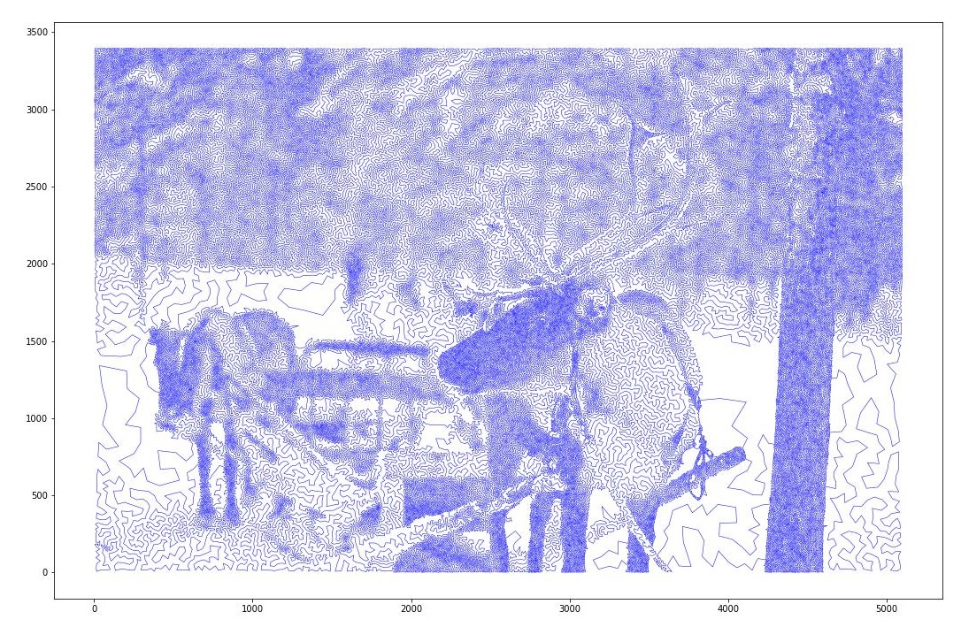
A sample path (my final submission, score 1,515,249.16)

Slide 6

Final Leaderboard
All cities in original order – 446,884,407.52
Nearest neighbour - 1,812,602.19

Slide 7
Review of Research and Methods

Slide 8
History of the Traveling Salesman Problem
Studied by mathematicians since 1930s
Proven to be NP-hard
Largest TSP solved exactly – 85,900 cities (2006)
Since 1970s, many approximate methods (heuristics) based on gradually improving existing tours by making small changes, have been developed.
Modern TSP solvers can usually find solutions within less than 1% margin from the optimal score

Slide 9

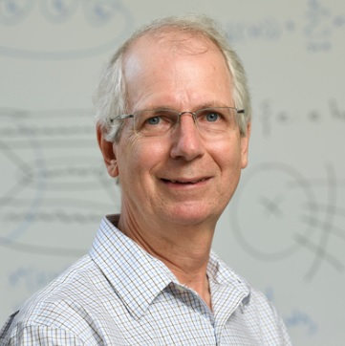
The best existing Traveling Salesman Problem (TSP) solvers
LKH – by Keld Helsgaun, Roskilde University, Denmark
Concorde – by William Cook, University of Waterloo, Canada

Slide 10
Basic idea – use existing TSP solvers, then rearrange the route to move prime cities into 10th step locations
Prime penalty – about 10% * 10% = 1% of total tour length – fairly small
Given how good existing solvers are, it makes sense to try to generate the best solution without penalty and then try to optimize it
Alternative approach – modify existing C++ code in solvers to include penalty – much harder to do

Slide 11
Basic idea – use existing TSP solvers, then rearrange the route to move prime cities into 10th step locations (continued)
197,768 non-starting cities, 17,802 primes (9.00%)
For 19,776 penalty locations, expect 1,780 primes in a solution not optimized for penalty
My final solution – 3,967 primes (20.06%)
Prime Mover’s kernel solution – 5,155 primes (26.07%)!

Slide 12
Approach 1: Nearest Neighbour
Fast to implement
Gives a decent initial solution (score 1,812,602), but still very suboptimal since at some point the algorithm runs out of close neighbours
Possible to improve by looking ahead and optimizing short paths (e.g. choose 5 closest neighbours and permutate), but the improvement is not great

Slide 13
Approach 2: Permutations
Try all permutations of cities to determine the optimal path
Time cost: n! ( for 197,768 cities ~ 10^{960,000} )
If we evaluate 10⁹ permutations/second, need about a day for n = 17, a year for n = 19
Held-Karp algorithm: O(n!) -> O(2^{n} * n²)
..., 10, 11, 12, 13, 14, 15, ...
Optimal order of the inner terms doesn’t depend on outer terms
Can do n = 25 in a day with 24 processor cores

Slide 14
Approach 3: Minimum Spanning Tree and Alpha-Nearness
Minimum Spanning Tree (MST) - a subset of the edges of a connected, edge-weighted undirected graph that connects all the vertices together, without any cycles and with the minimum possible total edge weight.
Much easier to find than the optimal closed path.
Prim’s (Jarnik’s) algorithm:
Start with an arbitrary vertex
At each step, add the shortest edge from a vertex within the tree to a vertex outside of it
Run time: O(m log(n)), where m is the number of edges and n the number of vertices

Slide 15
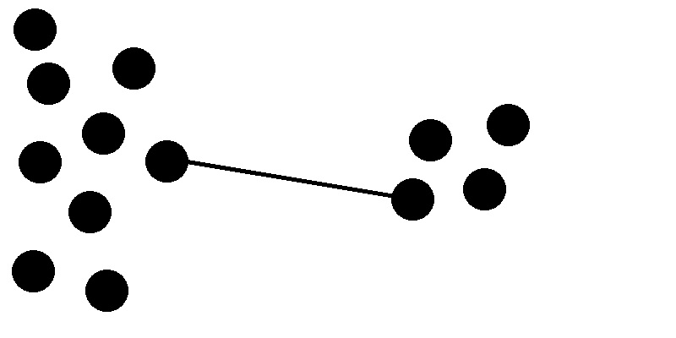
Approach 3: Minimum Spanning Tree and Alpha-Nearness (continued)
α-nearness for two cities: difference between distance on the minimum spanning tree (1-tree) and the Euclidian distance.
Zero and small values of α-nearness indicate that the cities are likely to be connected in the optimal path.
Shortest nearest neighbour tour: 1,812,602
Shortest α-nearest neighbour tour: 1,703,601

Slide 16
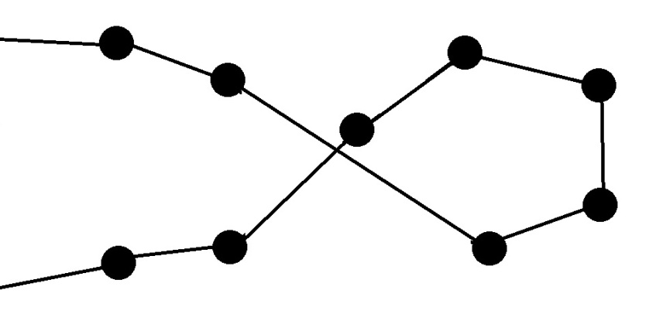
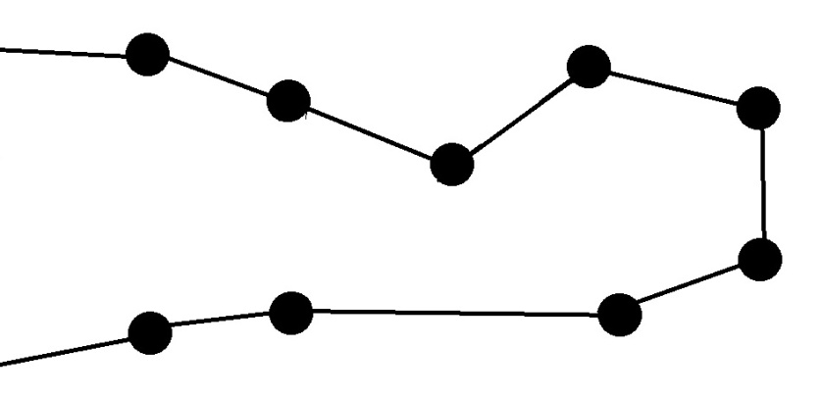
Approach 4: Heuristics (k-opt)
Basic idea – replace k edges (connections between cities) of path with k different edges.
Lin, Shen; Kernighan, B. W. (1973). "An Effective Heuristic Algorithm for the Traveling-Salesman Problem". Operations Research. 21 (2): 498–516.
Helsgaun, K. “General k-opt submoves for the Lin–Kernighan TSP heuristic”. Math. Prog. Comp. (2009) 1: 119.
2-opt:

Slide 17
Approach 4: Heuristics (k-opt) - continued
To use a sequential k-opt for any k:
Break a random edge, replace it with an edge from one of the two affected vertices (which now have 1 edge) to a different vertex based on nearness or α-nearness
From the vertex that now has 3 edges, remove one of the old edges, which would leave another vertex with 1 edge
Add an edge to that vertex based on nearness or α-nearness, etc
At some point, close the loop by going to the second original vertex

Slide 18
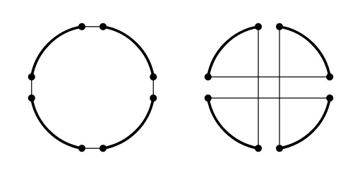
Approach 4: Heuristics (k-opt) - continued
Non-sequential k-opts are also very important due to the fact that they do not require all points to be close together.
Example of a non-sequential 4-opt:
Image from http://tsp-basics.blogspot.com/2017/04/4-opt-and-double-bridge.html

Slide 19
Approach 5: Escaping local optima by suboptimal moves + reoptimizing (kicks)
TSP seems to be particularly prone to local optima
To escape these, need to sometimes make moves that worsen the tour length and then optimize again, hoping that the resulting length is an improvement over the starting length
Blazinskas, A. “Combining 2-opt , 3-opt and 4-opt with K-swap-kick Perturbations for the Traveling Salesman Problem.” (2011).

Slide 20
Approach 6: Combining solutions (genetic algorithms!)
Iterative Partial Transcription (IPT) and Generalized Partition Crossover (GPX) – Essentially, the idea is to merge tours by finding segments that start and end at the same cities and have the same set of cities in between, and choosing the better one.
Edge Assembly Crossover (EAX) – includes mutations (edges that are not present in either parent), may temporarily increase the tour length
Nagata, Y., & Kobayashi, S. (2013). A Powerful Genetic Algorithm Using Edge Assembly Crossover for the Traveling Salesman Problem. INFORMS Journal on Computing, 25(2), 346–363.

Slide 21
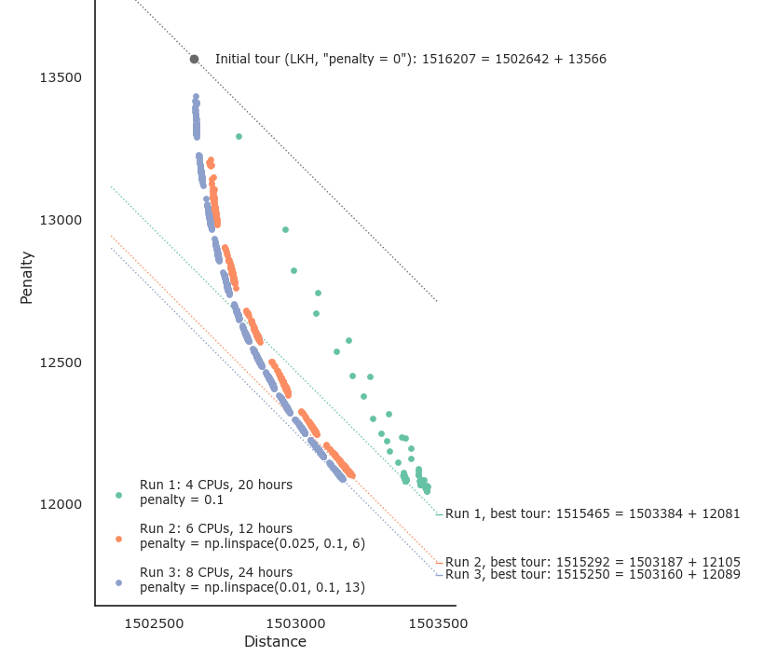
The Gradual Weight Reduction Strategy
From https://www.kaggle.com/c/traveling-santa-2018-prime-paths/discussion/77357

Slide 22
Machine Learning Approaches?
Some existing research on using machine learning for TSP problems:
Gambardella, LM, Dorigo M. “Ant-Q: A Reinforcement Learning approach to the traveling salesman problem.” (1995).
Vinyals O, Fortunato M, Jaitly N. “Pointer Networks” (2015)
Bengio Y, Lodi A, Prouvost A. “Machine Learning for Combinatorial Optimization: a Methodological Tour d'Horizon” (2018)
Unfortunately, all of these approaches seem not to scale well for large problems
None of the winners mention using ML

Slide 23
Performance optimization
Most winners used fast languages (C++, Rust)
Good python solutions employed many advanced time optimization tricks, multithreading via running multiple processes

Slide 24
Python performance optimization: Numba
Numba translates Python functions to optimized machine code at runtime using the industry-standard LLVM compiler library. Numba-compiled numerical algorithms in Python can approach the speeds of C or FORTRAN.
Sample code (about 30 times faster with numba):
import numba
@numba.jit('i8(i4)', nopython=True, parallel=False)
def sum_numba(n):
s = 0
for i in range(n):
s += i
return s
Doesn’t increase speed significantly for highly optimized numpy code

Slide 25
Winners’ Solutions

Slide 26
1st place solution (Prime Mover) – based on posted kernel with links to C++ code
Pure TSP with LKH including dividing the problem into 5 subproblems – 1,516,360.
Lin-Kernighan with prime penalty and kicks to escape local minima – 1,514,715.
Break the tour into subproblems and optimize each separately using LKH with prime and varying subproblem size (10,000 -> 5,000 -> 7,500 -> 6,250) – 1,514,358.
More global Lin-Kernighan – 1,514,325.
Actual competition score 1,513,747 – either ran these a lot longer or used some other tricks.

Slide 27
2nd place solution (Farmers peeing further...)
Pure TSP with LKH
Custom Lin-Kernighan with slowly increasing penalty 1%, 2%, ..., 10%
Use kicks to get out of local optima: a) Make several 8-opt moves that do not increase length by more than 20, then optimize; b) alter the penalty either up or down and optimize
Merge tours by finding segments that start and end at the same cities and have the same set of cities in between, and choosing the better one (custom implementation of IPT)
Run everything on 72 and 48 core machines, coded in Rust

Slide 28
3rd place solution (NighTurs)
Pure TSP with LKH – 1,516,321.
Run penalty aware steepest descent Lin-Kernighan – 1,514,683.
Try applying higher opts (up to more than 20-opt) – 1,514,610.
Kick tour, reoptimize – 1,514,245.
Kick tour, reoptimize with tricks from 3, recombine with GPX2 – 1,514,014.

Slide 29
5th place solution (Random Traveling)
Pure LKH – 1,516,290.
K-opt with penalty up to k = 5 – 1,515,325.
To avoid getting stuck in local optima, only accept moves that do not increase base (non-penalty) length too much – 1,515,118.
Use local permutations and other k-opt moves – 1,514,977.
EAX algorithm – 1,514,223.

Slide 30
8th place solution (Zidmie|Kha|Marc|Simon)
Pure LKH – 1,516,256.
2- and 3-opt – 1,515,8xx.
Non-sequential 4-opt – 1,515,6xx.
Gradually increasing penalty trick – 1,515,4xx.
CumSum trick for fast scoring (precomputing scores for all offsets) – 1,514,9xx.
Kicks to escape local minima by up to 5-opt – 1,514,7xx.
Tried combining tours by EAX – slight improvement, still 1,514,7xx.
Shuffle cities on segments up to 200 using lower bound estimation – 1,514,5xx.
Keep using different methods – 1,514,438.

Slide 31
47th place solution (Stan Kriventsov)
Pure LKH – 1,516,390.
2- and 3-opt – 1,515,9xx.
Non-sequential 4-opt – 1,515,6xx.
5-opt and local permutations – 1,515,4xx
Combining solutions, running more optimization – 1,515,249.
Biggest difference from winners’ solutions – never found an effective way to escape local minima.
What I could do better:
Use C++ instead of Python
Read more papers instead of trying to figure things out by myself!

Slide 32
Other approaches
Integer Linear Programming (36th place team) - based on the Miller-Tucker-Zemlin (MTZ) formulation of TSP for local optimization of sequences of 50 to 500 cities. Seems to have worked reasonably well for them, bringing the score from 1,515,656 to 1,515,172.
Simulated Annealing – many teams have tried it, but didn’t seem to yield great results

Slide 33
Thank you!
Questions?

